Slide 1
5. MCM-6 Good Housekeeping at Municipal Facilities: MS4 Stormwater System Maintenance
Green Country Stormwater Alliance (GCSA)
Employee Training Series
Prepared by INCOG
March 2021
Notes:
Module 5 addresses stormwater pollution prevention measures that can be taken when performing maintenance or new construction of the MS4 collection system.
Many of the BMPs useful for general house and building construction also apply to soil disturbance activities that occur when local crews perform Public Works maintenance.
EPA stormwater rules and the DEQ OKR04 stormwater general permit define the city’s or county’s “Municipal Separate Storm Sewer System” (MS4) broadly.
In addition to culverts and storm sewer pipes, the definition of “MS4” includes streets and roads with ditches.
This means that municipal repairs and new construction of streets, roads and ditches are actually being made to the OKR04-permitted MS4 infrastructure.
Therefore, these activities fall under OKR04’s 6th Minimum Control Measure (MCM-6) for Good Housekeeping.

Slide 2
Definition of “Illicit Discharge”
OKR04 Part I.H: Illicit Discharge is defined at 40 CFR §122.26(b)(2) and refers to any discharge to a municipal separate storm sewer that is not entirely composed of stormwater, except discharges authorized under an OPDES or NPDES permit (other than the OPDES permit for discharges from the MS4) and discharges resulting from firefighting activities.
Notes:
In order to consider pollution that comes from maintenance of MS4 systems, we need to know how EPA and DEQ define pollution.
The term used in stormwater permits and rules is “Illicit Discharge” (ID) which means the conveyance in stormwater flows (discharges) of pollutants (illicit substances).
The definition of “Illicit Discharge” is purposely very broad with key words and phrases.
ID begins by stating “any” discharge: this means that there are no lists of pollutants, therefore “any” type of substance is not allowed.
An ID must be discharged to the MS4 system to be considered an illicit discharge by definition.
The most important phrase, however, is that the discharge of an ID is anything “not entirely composed of stormwater”.
This phrase means that the permitted city or county does not have to measure pollutant concentrations or prove that any Water Quality Standard (WQS) was violated.
“Any” substance discharged to an MS4 that is not uncontaminated water is not allowed by the OKR04 permit.

Slide 3
Definition of “MS4”
OKR04 Part I.M: Municipal Separate Storm Sewer System (MS4) …. The term MS4 is defined at 40 CFR § 122.26(b)(8) and means a conveyance or system of conveyances (including roads with drainage systems, municipal streets, catch basins, curbs, gutters, ditches, man-made channels, or storm drains) that is/are
owned or operated by a state, city, town, borough, county, …. that discharges to waters of the United States;
designed or used for collecting or conveying stormwater;
not a combined sewer; and
not part of a Publicly Owned Treatment Works (POTW) as defined at 40 CFR § 403.3(q).
Notes:
Another important definition is how MS4 is defined.
The definition includes many examples of MS4: “roads with drainage systems, municipal streets, catch basins, curbs, gutters, ditches, man-made channels, or storm drains”.
These are just examples indicating that the definition encompasses any municipally owned or operated physical feature that conveys stormwater.
Because this conveyance definition is so broad, it brings in many city or county construction and repair activities that may not have been thought of as work performed on MS4 systems.
For example, patching potholes, making saw cuts in concrete streets, cleaning out street gutters and re-grading or sodding roadside ditches are all actions to the MS4 system.

Slide 4
MS4 Stormwater Drainage System Maintenance
This presentation provides commonly used BMPs for controlling pollutants in stormwater runoff to address the following:
Pavement Repair
Paint Striping
Storm Drain Inlet Cleaning and Marking
Ditch Maintenance
Street Cleaning
Reporting Pollution and Illegal Dumping Activities
Notes:
This Module 5 covers several of the most common maintenance and new construction activities performed on MS4 systems.
Each of these activities involves the use of chemicals that need to be handled carefully to avoid spills and for which special cleanup procedures are needed.
In addition, many other activities require outside storage of stockpiles of dirt or sand that should be protected from rainfall runoff.
Module 5 concludes by providing lists of contacts for reporting spills of chemicals and for worker safety.

Slide 5
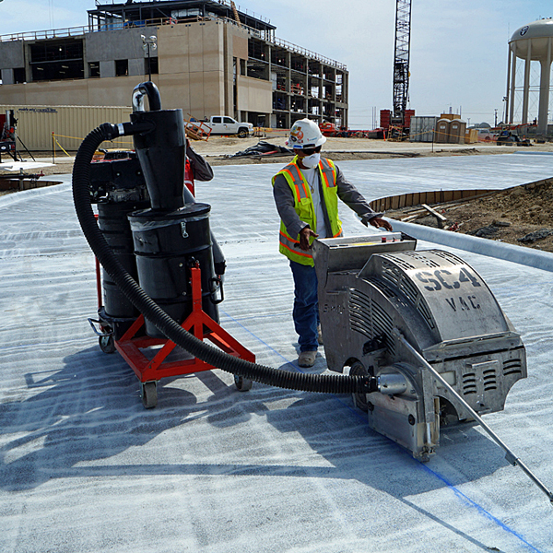
Pavement Repair: Saw Cuts
Vacuum the slurry and cuttings from saw-cutting operations.
Don’t allow the slurry to enter the storm drain or to remain on pavement to dry out.
Properly dispose of the slurry to prevent a discharge into the storm water system or a water body.
Notes:
Use of motorized cutting tools for making concrete cuts produces a lot of dust that is highly caustic and dangerous to breathe.
Consequently, most cutting tools apply water to the dust, but this slurry of concrete dust in water will run off into ditches and creeks where it can be harmful to aquatic life.
This is considered an “illicit discharge” of pollution which needs to be controlled.
Even if the slurry is allowed to dry on the pavement with the intentions of coming back to sweep it up, a rain event will wash the cuttings into the storm system and into the creek.
The most helpful Best Management Practice (BMP) to control discharges of concrete slurry water is to use a wet vacuum system during cutting.
The slurry water collected must be disposed of properly, not poured into a storm drain, ditch or creek.
Your supervisor and/or local stormwater program manager should have procedures for proper disposal of slurry water.

Slide 6
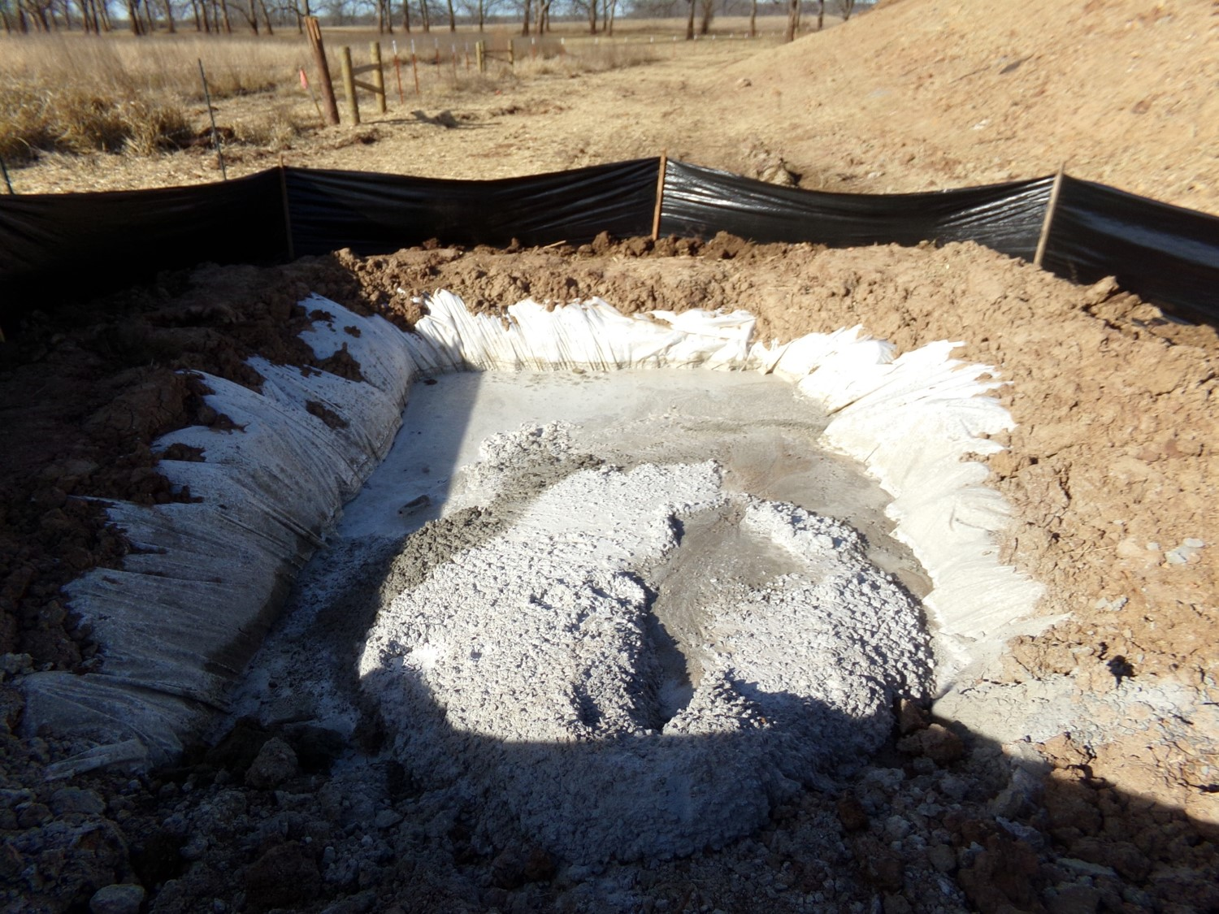
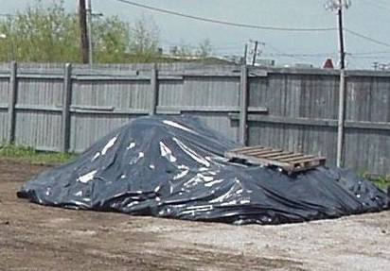
Pavement Repair: Material Storage & Disposal
Require concrete trucks to wash out in a designated location.
Prevent wash water from entering storm drains, ditches or creeks.
Locate stockpiles of asphalt patching material on a concrete or paved surface.
Cover stockpiles to prevent contact with rain.
Notes:
Two common pollution sources at construction sites are improper washout of concrete trucks and equipment, and improper stockpiling of dirt and sand.
Spreading of concrete wash water and emptying concrete residuals from mixers on the ground is prohibited.
A good BMP for concrete residual and wash water disposal is to dig a pit at the construction site or provide a containment barrier system and collect the wash water and residuals in the pit.
The water soaks in the ground and evaporates leaving the solids which can then be collected and sent to a municipal landfill for disposal.
Stockpiles of dirt, sand and other materials can leach sediments during rainfall.
BMPs for stockpiles include use of plastic tarp coverings or installing berms or silt fencing around the stockpiles to prevent wash-off of sediment particles or chemicals during rainfall.
In addition, stockpiles of salt and salt-sand mixtures at municipal maintenance facilities should have the same type of BMP pollution protection.

Slide 7
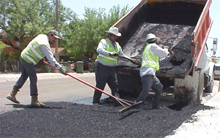
Pavement Repair: Patching
Mix only the amount of patching material necessary to complete the repair.
Sweep up and properly dispose of all patching material that is not compacted or is left over from the repair.
Notes:
Asphalt cold patch and hot mix both can leach strong organic chemicals that can be washed from the site as pollution in stormwater runoff.
A good BMP for applications is to mix and use an amount needed without having too much excess for disposal.
Another good BMP is to sweep up excess patching material for proper disposal or reuse.

Slide 8
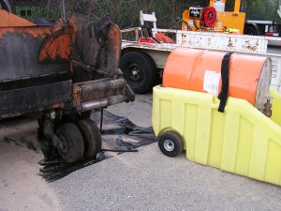
Pavement Repair: Cleanup
Use a biodegradable release agent (not diesel) for asphalt patching and cleanup activities.
Clean trucks, equipment and tools in designated equipment wash facilities
Prevent wash water from entering a storm drain, ditch or surface water.
Notes:
Diesel has been used as a release agent for years because it is a good solvent for asphalt.
However, diesel spilled on asphalt pavement will dissolve the asphalt and can result in the development of a new pothole.
There are new release agents that are safer for the environment, do not damage roadways and are worth trying.
After the work is completed, equipment should be cleaned in designated areas only that are suitable for retaining chemicals for reuse or proper disposal.
Wash water and chemical solvents should never be disposed of in storm drains or poured on the ground.
Such materials will eventually be carried to local creeks and ponds in stormwater runoff.

Slide 9
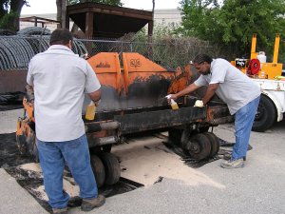
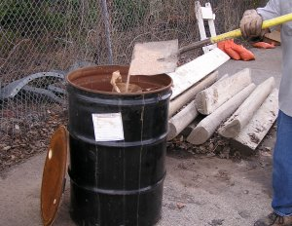
Pavement Repair: Cleanup
If no wash facility is available, clean equipment over absorbent material spread on a paved surface or heavy plastic sheeting.
Promptly sweep up the absorbent and dispose of properly.
Notes:
There may be times when cleanup fluids and solvents cannot be used in designated areas.
In such cases, before beginning cleanup, spread absorbents under and around the cleaning area.
Placing the absorbents on a tarp or mat will help with collection and removal of the absorbents.
After cleanup, dry-sweep the absorbent materials and properly dispose of the waste materials.
Your supervisor will have procedures for proper disposal.
Try to minimize the use of solvents and other chemicals; this will make cleanup and waste disposal easier.

Slide 10
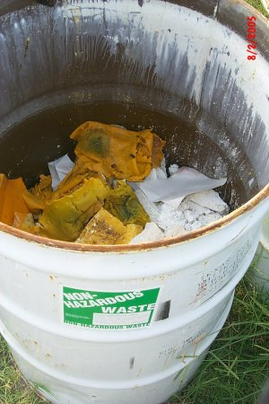
Paint Striping: Latex Paint
Schedule painting and striping projects during dry weather only.
Waste handling for water-based latex paint:
Pour small quantities of unused paint in open barrels and allow to dry. Dispose of dried paint in trash.
Collect wash water used for equipment cleaning and dispose of in sanitary sewer.
Notes:
Water-based latex paints are preferred for many applications due to easier mixing and cleanup.
However, latex paints, being water soluble, will tend to wash off during rainfall until thoroughly dry, so schedule striping and painting jobs for fair weather conditions.
Latex paints may be accepted at recycling facilities for disposal where they are blended with other latex paints for reuse.
For small amounts of latex paint left in containers, store with the lid off to dry or pour the small quantities in open barrels for drying.
For larger quantities, there are commercial products that can be mixed with latex paint to instantly harden the mixture for disposal.
Reuse of latex paints is the most favorable BMP; the blends of paints can be used for painting city properties and outside structures.
Dispose of cleanup wash water of equipment and brushes in the sanitary sewer. Do not pour cleaning liquids into gutters, inlets, ditches or creeks.

Slide 11
Paint Striping: Oil-Based Paint
Waste handling for oil-based paint:
Reuse and recycle oil-based paints as much as possible.
Dispose of oil-based paints and solvents used for equipment cleaning in accordance with established procedures.
Follow manufacturer’s and your organization’s guidance on proper disposal options.
Notes:
Oil-based paints tend to have the advantage of greater durability, but their use and cleanup requires harsh chemicals and solvents.
Reuse and recycle oil-based paints as much as possible. There are many commercial recycling centers that will accept oil-based paints.
Consult with your supervisor on the procedures to use for proper disposal of oil-based paints.
Never dispose of solvents or cleaning solutions in gutters, inlets, ditches or creeks.
Oil-based paints and solvents are highly toxic to aquatic life.

Slide 12
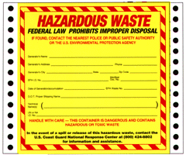
Hazardous Waste Disposal
Many waste materials are classified as Hazardous waste by type and quantity.
The laws are complex. When in doubt, check with your supervisor.
Commercial products that are to be discarded become waste.
If they are classified as Hazardous Waste, you become the “Generator” and must assume responsibility until final disposal.
Transferring ownership to another company does not relieve you of this “cradle to grave” responsibility; it’s still your waste.
Notes:
Materials that are designated as Hazardous Waste under federal and state rules are based upon the types and quantities of the material.
The federal and state hazardous waste rules are very complex involving several major laws and dozens of different regulations (rules).
When a city or county purchases a material for use, it is not a “waste”.
However, any material that is no longer needed and is not to be recycled or reused becomes a waste material.
If the waste material is of a certain type of chemical, blend of chemicals, and in certain quantities, it may be defined as “Hazardous Waste” under one or more laws and rules.
Your organization becomes the waste “Generator” of formerly useful products that now must be disposed of and meet the definition of Hazardous Waste.
The generator of the hazardous waste remains responsible for the waste until it is properly disposed of. This is often referred to as “Cradle to Grave” in handling hazardous waste.
You are responsible for the proper storage, transport and final disposal of all Hazardous Waste you generate.
Improper handling, releases or disposal of your waste, even by a third party to which you legally transferred responsibility, will still be your legal liability.

Slide 13
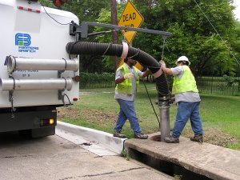
Storm Drain Inlets: Cleaning
After dewatering, trash and debris can be removed from storm water systems.
Dispose of collected material in a sanitary landfill.
Clean up any spilled material from the work site.
Report suspected dumping or pollution problems to your supervisor.
Notes:
Storm drains collect so much trash, sediment and plant materials that blockages form, preventing the free-flow of stormwater.
Specialized equipment must then be used to remove this debris.
The materials collected with these inlet cleaning activities must be disposed of properly, preferably in a municipal or sanitary landfill.
In addition, after completing each inlet cleanup, sweep up all materials spilled around the site.
Report to your supervisor any suspected illegal disposal or waste dumping that you find.

Slide 14
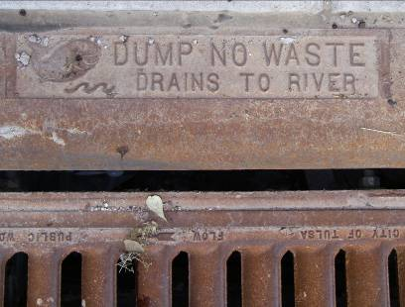
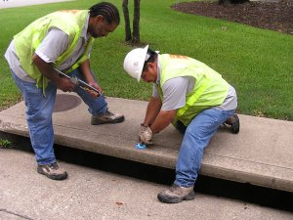
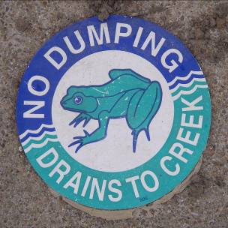
Storm Drain Inlets: Marking
“Marking” storm drain inlets is a popular public education BMP.
It reminds citizens to not pour liquids or place solid materials, like grass clippings, in drop inlets.
Most cities purchase markers, medallions or placards that can be glued to the inlet.
Some drop inlet grates have the message imprinted on the grate itself.
Notes:
Placing messages for the public on storm drain drop inlets is a popular BMP.
The messages encourage proper disposal of wastes and remind people that storm drains flow directly to ponds and creeks, never to some treatment plant.
Your organization may request your help with placing markers on drop inlets; these can be plastic placards, medallions, or messages spray-painted directly with stencils.
When you visit a drop inlet, make sure that any marking is still clearly visible. If it is damaged or faded, notify your supervisor so that it can be repaired or replaced.

Slide 15
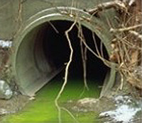
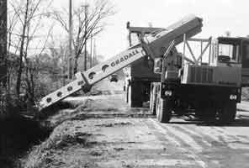
Ditch Maintenance: Pollution Find
Pollution is often found during routine ditch maintenance.
Contact your supervisor or stormwater manager of the find.
Most pollutants that are discovered are of unknown identity.
Your city management will have formal procedures for testing and cleanup.
Notes:
Whenever municipal crews travel to or are at an MS4 job site, they often find signs of potential pollution.
If pollution of any sort is found, report the incident to your supervisor. Do not attempt to examine the materials, there may be dangerous chemicals present.
The report you submit will trigger a formal chain of events to investigate the pollution problem under OKR04’s “source-tracing” requirement (MCM-3) for illicit discharges.
The fire department or a Hazmat team may have to be contacted if the initial investigators need help with potentially dangerous pollutants at the site.
Often, additional resources may need to become involved, such as an emergency response company, consultant, waste disposal company or DEQ investigators.
Locating the responsible party and ensuring cleanup may involve days of field and lab investigations, enforcement actions and negotiations between multiple parties.
But your job is the most important: the initial report of a “pollution find” that begins the process.

Slide 16
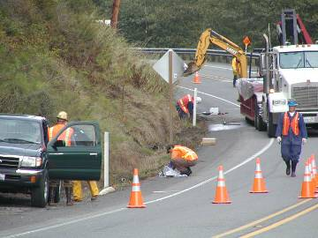
Ditch Maintenance: Pollution Find
Specialists, such as HAZMAT, will investigate pollution events.
Pollutants and contaminated water and sediments must be properly disposed of.
NEVER investigate unknown chemicals and substances yourself.
Your job is to simply report the find, not to investigate.
Safety first!
Notes:
Always remember that part of your job in MS4 system maintenance and new construction is to report pollution finds.
At that point, your involvement ends, other than perhaps answering questions about your initial observations.
Never investigate any chemicals or containers yourself; leave that to those with the proper training and equipment.
Your safety, and that of all workers, is paramount.

Slide 17
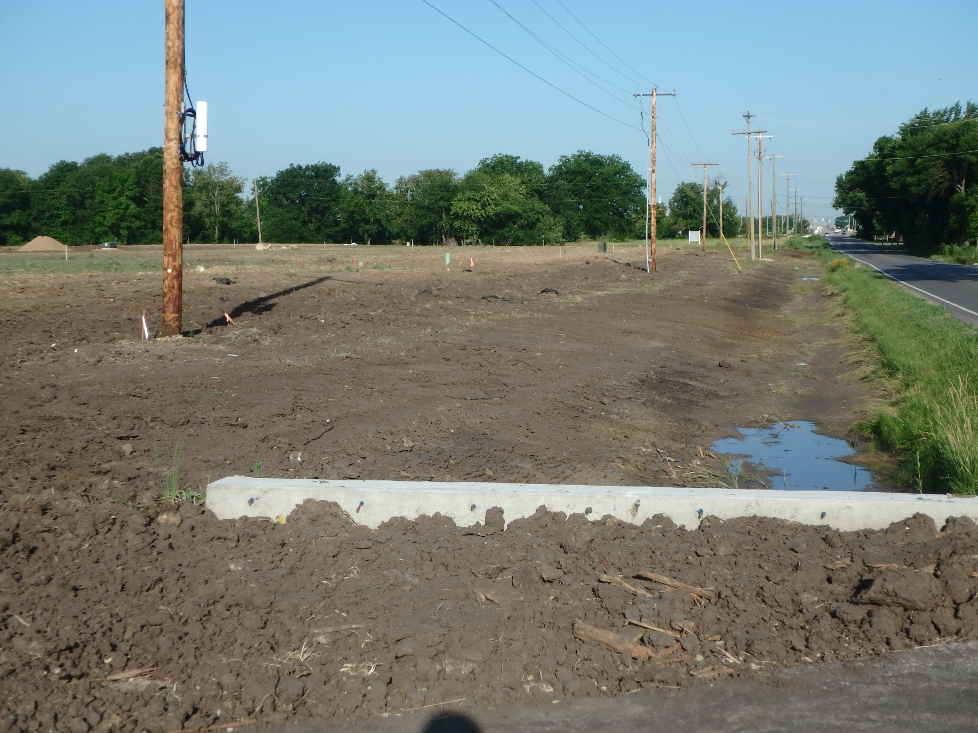
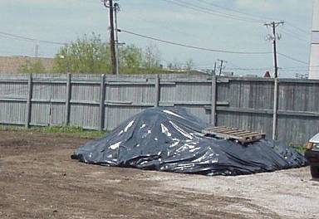
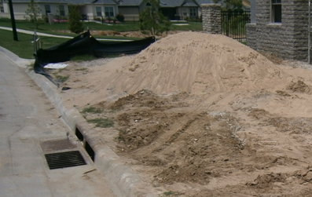
Ditch Maintenance: Stockpiles
Dirt is often used or removed from ditch maintenance sites.
Temporary stockpiles can release sediments during rainfall.
Cover soil stockpiles to prevent erosion and/or install a silt fence to capture sediment.
Protect inlets.
Notes:
It is often too easy to forget, or not have the time, to create protected enclosures or covers for temporary stockpiles of dirt, sand and other materials at construction sites.
In many cases, the materials come from the site itself during excavation.
Your supervisor and OKR04-permitted city or county should have procedures for onsite management of stockpiled and excavated materials.
Tarp coverings and/or silt barriers are the best BMPs to use for onsite management.
The goal is to prevent sediment from being eroded away in rainfall runoff into local storm drains or creeks as pollution.

Slide 18
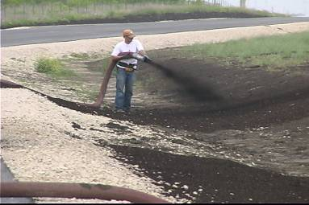
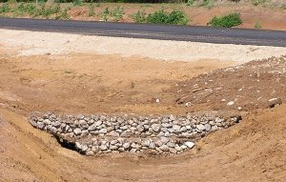
Ditch Maintenance: Erosion Control
Apply grass seed to exposed soils using a compost or mulch mixture to speed vegetation growth and prevent erosion.
Sod bare ground to prevent erosion.
Use turf reinforcement mats and/or check dams in high-flow areas until vegetation is established.
Notes:
Even gentle slopes can quickly erode soil during rainfall unless stabilized.
There are many types of “erosion control” BMPs to choose from; consult your supervisor for the best options for each site.
Spreading grass seed onto bare soil by itself is likely to fail, especially if the type of grass is not in its natural growing season or environment.
A more favorable option is to use mulches or slurries that combine seeds with fertilizers and an organic mulch that protects bare soil from rainfall erosion.
Many of these products are in a liquid form for spraying onto the soil directly.
Sod is another good BMP option if vegetation cover is required quickly for a site.
Some ditches can have such erosive flows that special devices need to be added to retard flow rates. These “check dams” slow down water velocity to reduce erosion.

Slide 19
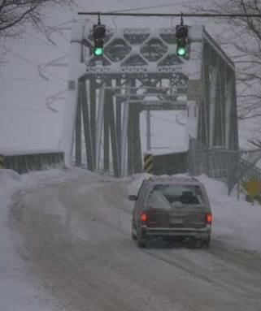
Minimize Pollution: Salt and Sand
Do not over-apply deicing salts and sand.
Routinely calibrate spreaders.
Use alternative deicing agents that are biodegradable, less toxic and less corrosive.
Consider using calcium magnesium acetate (CMA), potassium acetate (KA) or another substitute for sodium or calcium chloride.
Notes:
Most cities and towns in Oklahoma apply at least limited amounts of salt and sand/salt mixtures on roadways for ice control during harsh winters.
The salt used most, sodium chloride (NaCl – table salt in a rough crystal form) is plentiful and cheap, but it is also highly corrosive to vehicles, bridges and roads.
In addition, roadway salt eventually is carried by snow melt and rainfall into local ponds and creeks where it can have toxic effects.
In recent years, less toxic and less corrosive alternatives to NaCl salt are now available to cities for roadway applications.
CMA or KA won’t corrode metal structures as quickly as some of the cheaper deicing salts.
Lower maintenance and repair costs on bridges and other structures could off-set the higher material cost.
Consider using these less toxic and corrosive salts around bridges (which are over creeks and rivers) and around wetlands or other sensitive areas.
Truck spreaders should be calibrated and checked often to ensure proper amounts are dispersed.
The amounts of deicer chemicals should be recorded. If possible, sand and salt can be swept up from streets after the winter event ends.

Slide 20
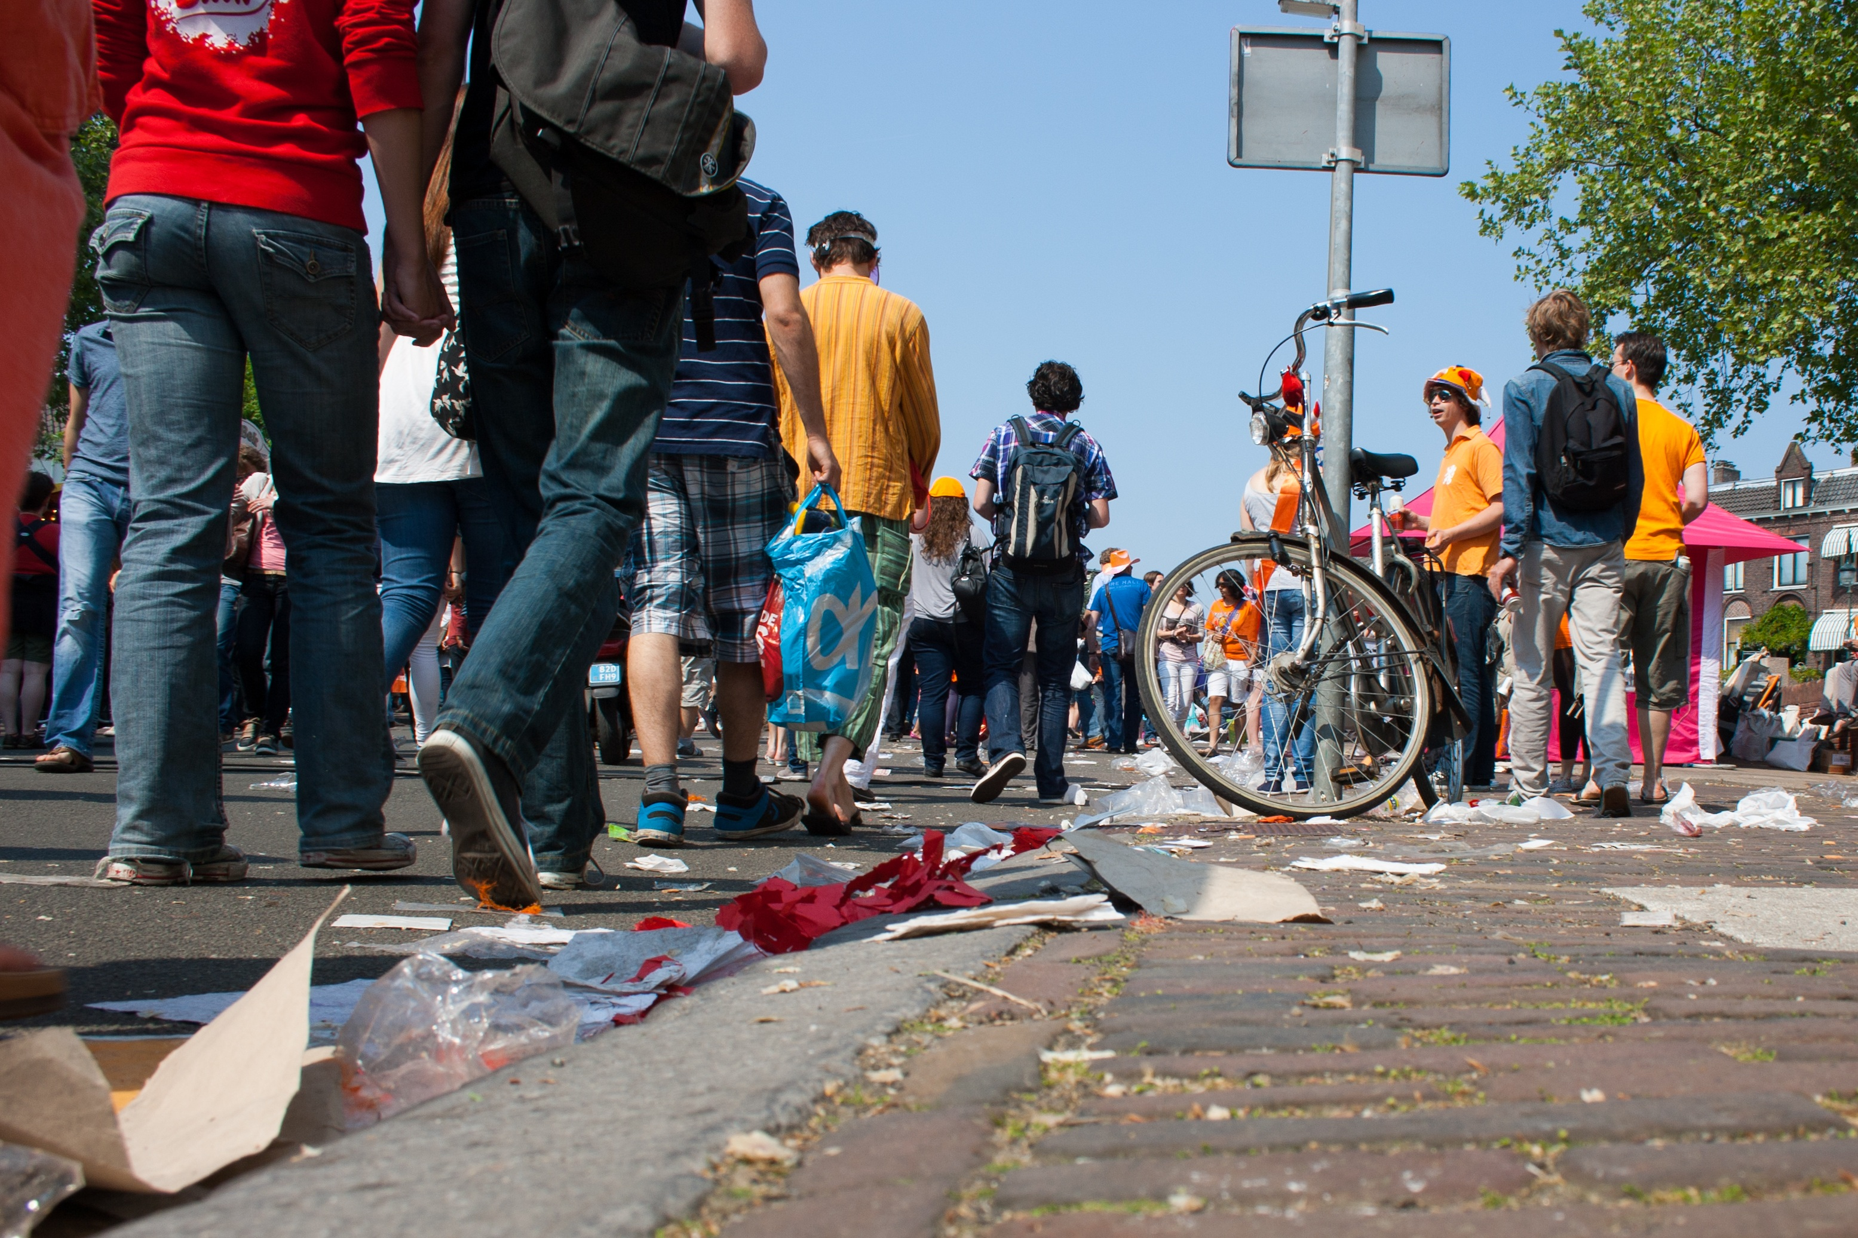
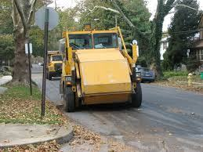
Street Sweeping: Trash, Sediment
Debris in streets can come from public gatherings, yard waste and soil disturbances.
These materials get washed into storm drains as pollutants.
Street sweepers remove materials before they become pollutants.
Dispose of collected debris in a permitted landfill.
Do not spread behind buildings or along creek banks.
Notes:
Streets are often the collectors of our community discards: trash, dirt, leaves, grass clippings, bottles… you name it, most types of “trash” ends up in street gutters.
All materials in streets are potential pollutants that can be washed down inlets, culverts and ditches into ponds and creeks.
An excellent BMP for removing street pollution is by using street sweepers.
If this BMP is used, records should be kept of amounts of debris removed, the frequency of seeping, and the miles of streets swept.
All materials removed from streets should be disposed of properly, preferably in a land fill.
Never stockpile of dispose of street sweeper contents by creeks or onto the ground where they can be washed into waterbodies as pollution.
Debris must pass a paint filter test and be deemed to not contain free liquids before going to a municipal landfill.
Therefore, sweep and collect before it gets wet or is flushed to a storm drain system by rain.

Slide 21
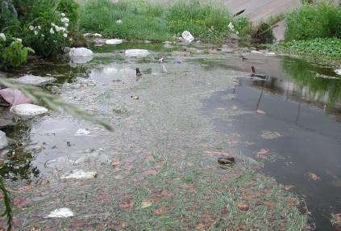
Report Pollution and Dumping
Look for pollution while on the job and report to your supervisor:
Pipes or hoses in storm water drains
Oil sheen on water surface
Excess trash and debris
Colored or cloudy water
Dry weather flows
Dead or dying fish
Unusual odors
Notes:
Pollution in stormwater systems isn’t difficult to identify; its done mostly by visual observation.
Many visual signs are obvious: dead animals, floating trash, bags or piles of yard waste, leaking chemical containers, etc.
Other types require a more thoughtful process: pipes or hoses that are in place to drain liquids (whether or not there is any flow), or trickle channels dug into creek banks.
Often you will see strange colors in the water or creek bank soils: green, blue, red, yellow, etc. that just doesn’t look right, and often by some pipe or channel.
Oil, even in tiny amounts, can turn the surface of the water a rainbow color, but often it’s difficult to see.
Report suspicious colors anyway; some materials can be very toxic and dangerous chemicals.
The biology in the stream can tell a story: dead or dying fish, masses of dead or luxurious growths of algae, stressed or dead plants, or masses of biological growth like slime or fungus.
Flowing water in dry weather in creeks and ditches where there should be none often indicates an illicit discharge upstream and should be reported.

Slide 22
Contacts: Hazardous Materials, Employee Safety
For hazardous waste questions in Oklahoma, visit DEQ: https://www.deq.ok.gov/land-protection-division/waste-management/hazardous-waste/
Oklahoma Public Employee Occupation, Safety & Health: https://www.ok.gov/Labor/SAFETY_&_HEALTH/Workplace_Safety/Public_Employee_Occupational_Safety_and_Health_(PEOSH)/index.html
EPA’s RCRA / Superfund / EPCRA Hotline: 800-424-9346
DOT Hazardous Materials Information Center: 800-467-4922 or 202-366-4488
Notes:
There are many federal and state agencies that have roles to play in hazardous waste handling and disposal and for worker safety.
The phone numbers and website addresses shown above have been recently updated.
Work with your supervisor on issues before making such contacts.

Slide 23
Contacts: Spills, Pollution Prevention
For reportable oil and chemical spills, call the US Coast Guard’s National Response Center at: 800-424-8802 or visit the website at: https://nrc.uscg.mil/Default.aspx
To talk to the DEQ Pollution Prevention Coordinator, call: 405-702-8179 or visit the DEQ website at: https://www.deq.ok.gov/external-affairs-division/for-business/pollution-prevention/
Notes:
Additional online and phone call resources for reporting oil and chemical spills and for Oklahoma pollution control measures and rules.

Slide 24
End of Module 5 on
Stormwater System Maintenance
Vernon Seaman
Manager, Envir. And Energy Planning
INCOG
Two West 2nd Street, Ste 800
Tulsa, OK 74103
(918) 579-9451
vseaman@incog.org
Notes:
This concludes the 5th of 6 annotated PowerPoint (aPPT) Modules for local MCM-6 training.
Training Presentations 2 through 5 cover the training subjects listed in the OKR04 permit.
The final Presentation 6 covers additional facilities that may be owned by GCSA Members.
INCOG expects to be able to return to physical half-day GCSA Employee Training Workshops in the second half of 2021.
In this interim period, INCOG will continue to prepare annotated PowerPoints (aPPTs) for local staff training use.

